Slide 1

Social Media Analytics OMIS 670
Presented by
Pooja Aishwarya Bonthula
Rohith Sai Katari

Slide 2


Slide 3
Agenda
Compare reviews of various airlines from Skytrax website
Inferences

Slide 4
Tools Used
Python to scrape and clean data
Power BI for visualization

Slide 5

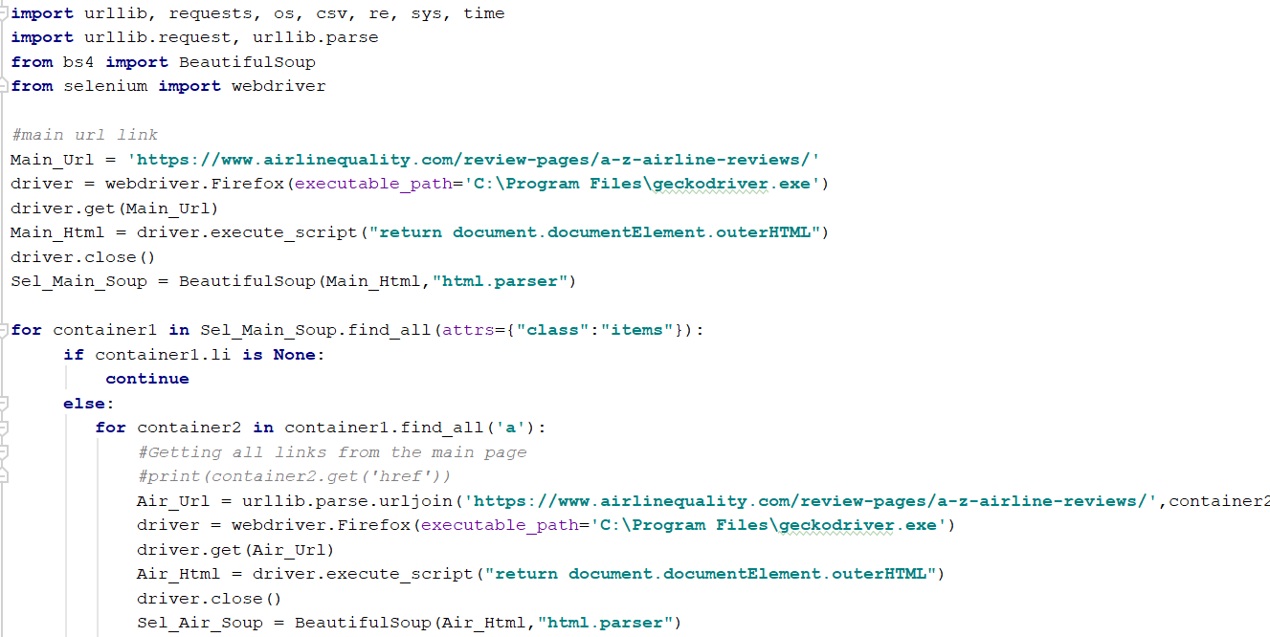
Data Scrapping

Slide 6
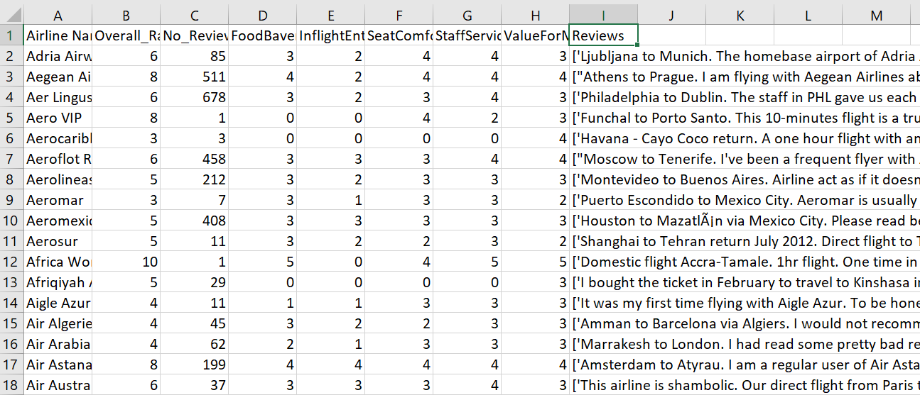
Data Scrapping

Slide 7
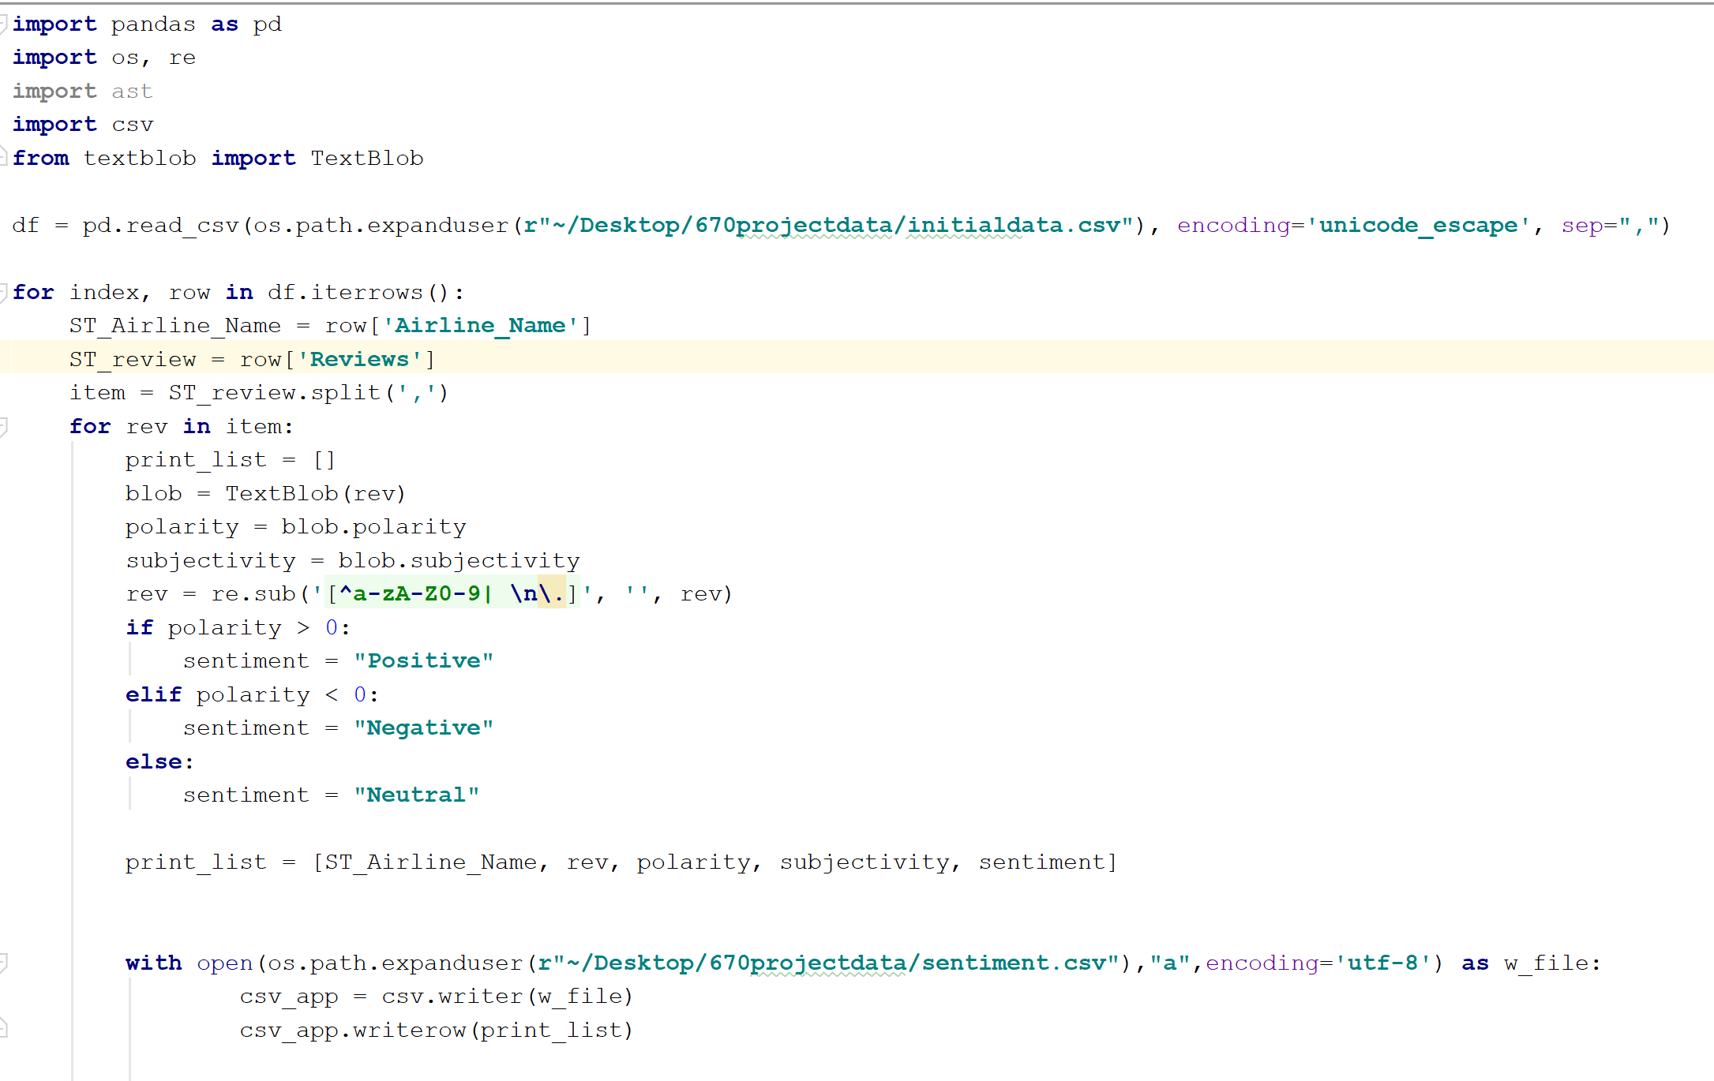
Sentiment Analysis

Slide 8
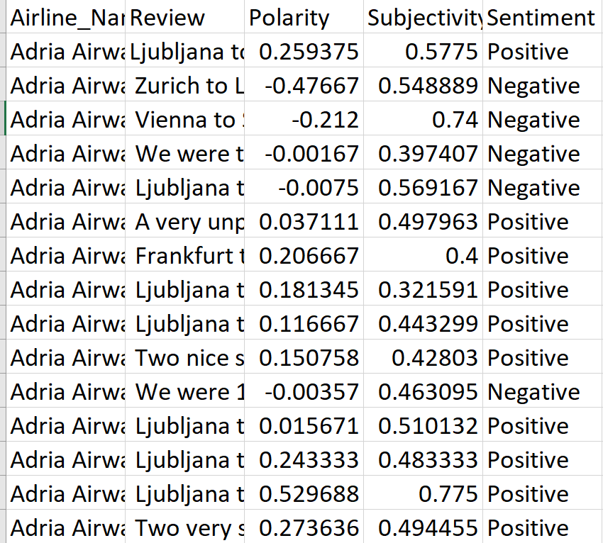
Sentiment Analysis

Slide 9
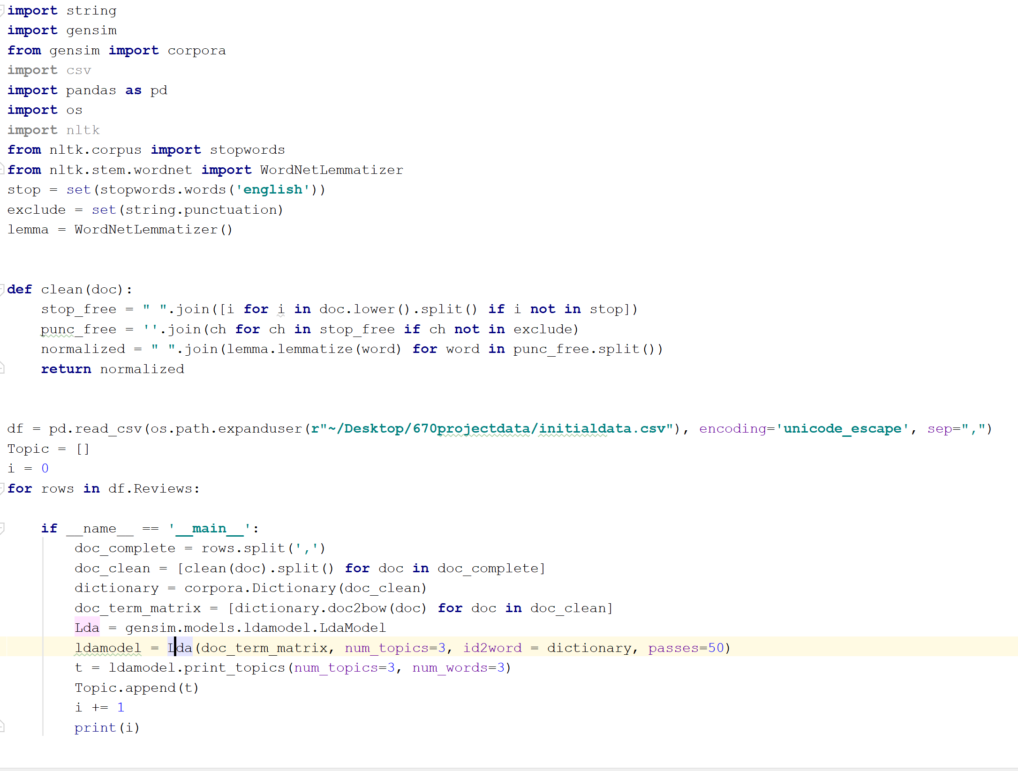
Topic Modeling

Slide 10
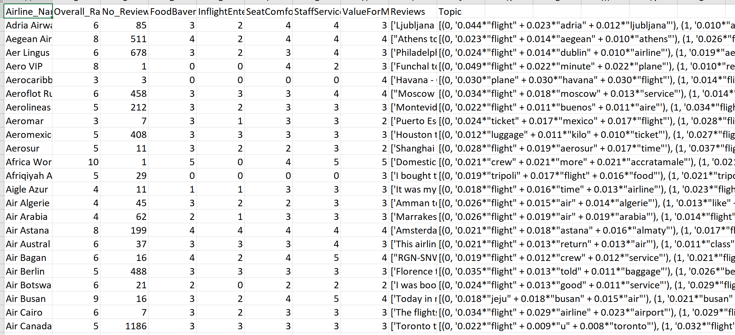
Topic Modeling

Slide 11
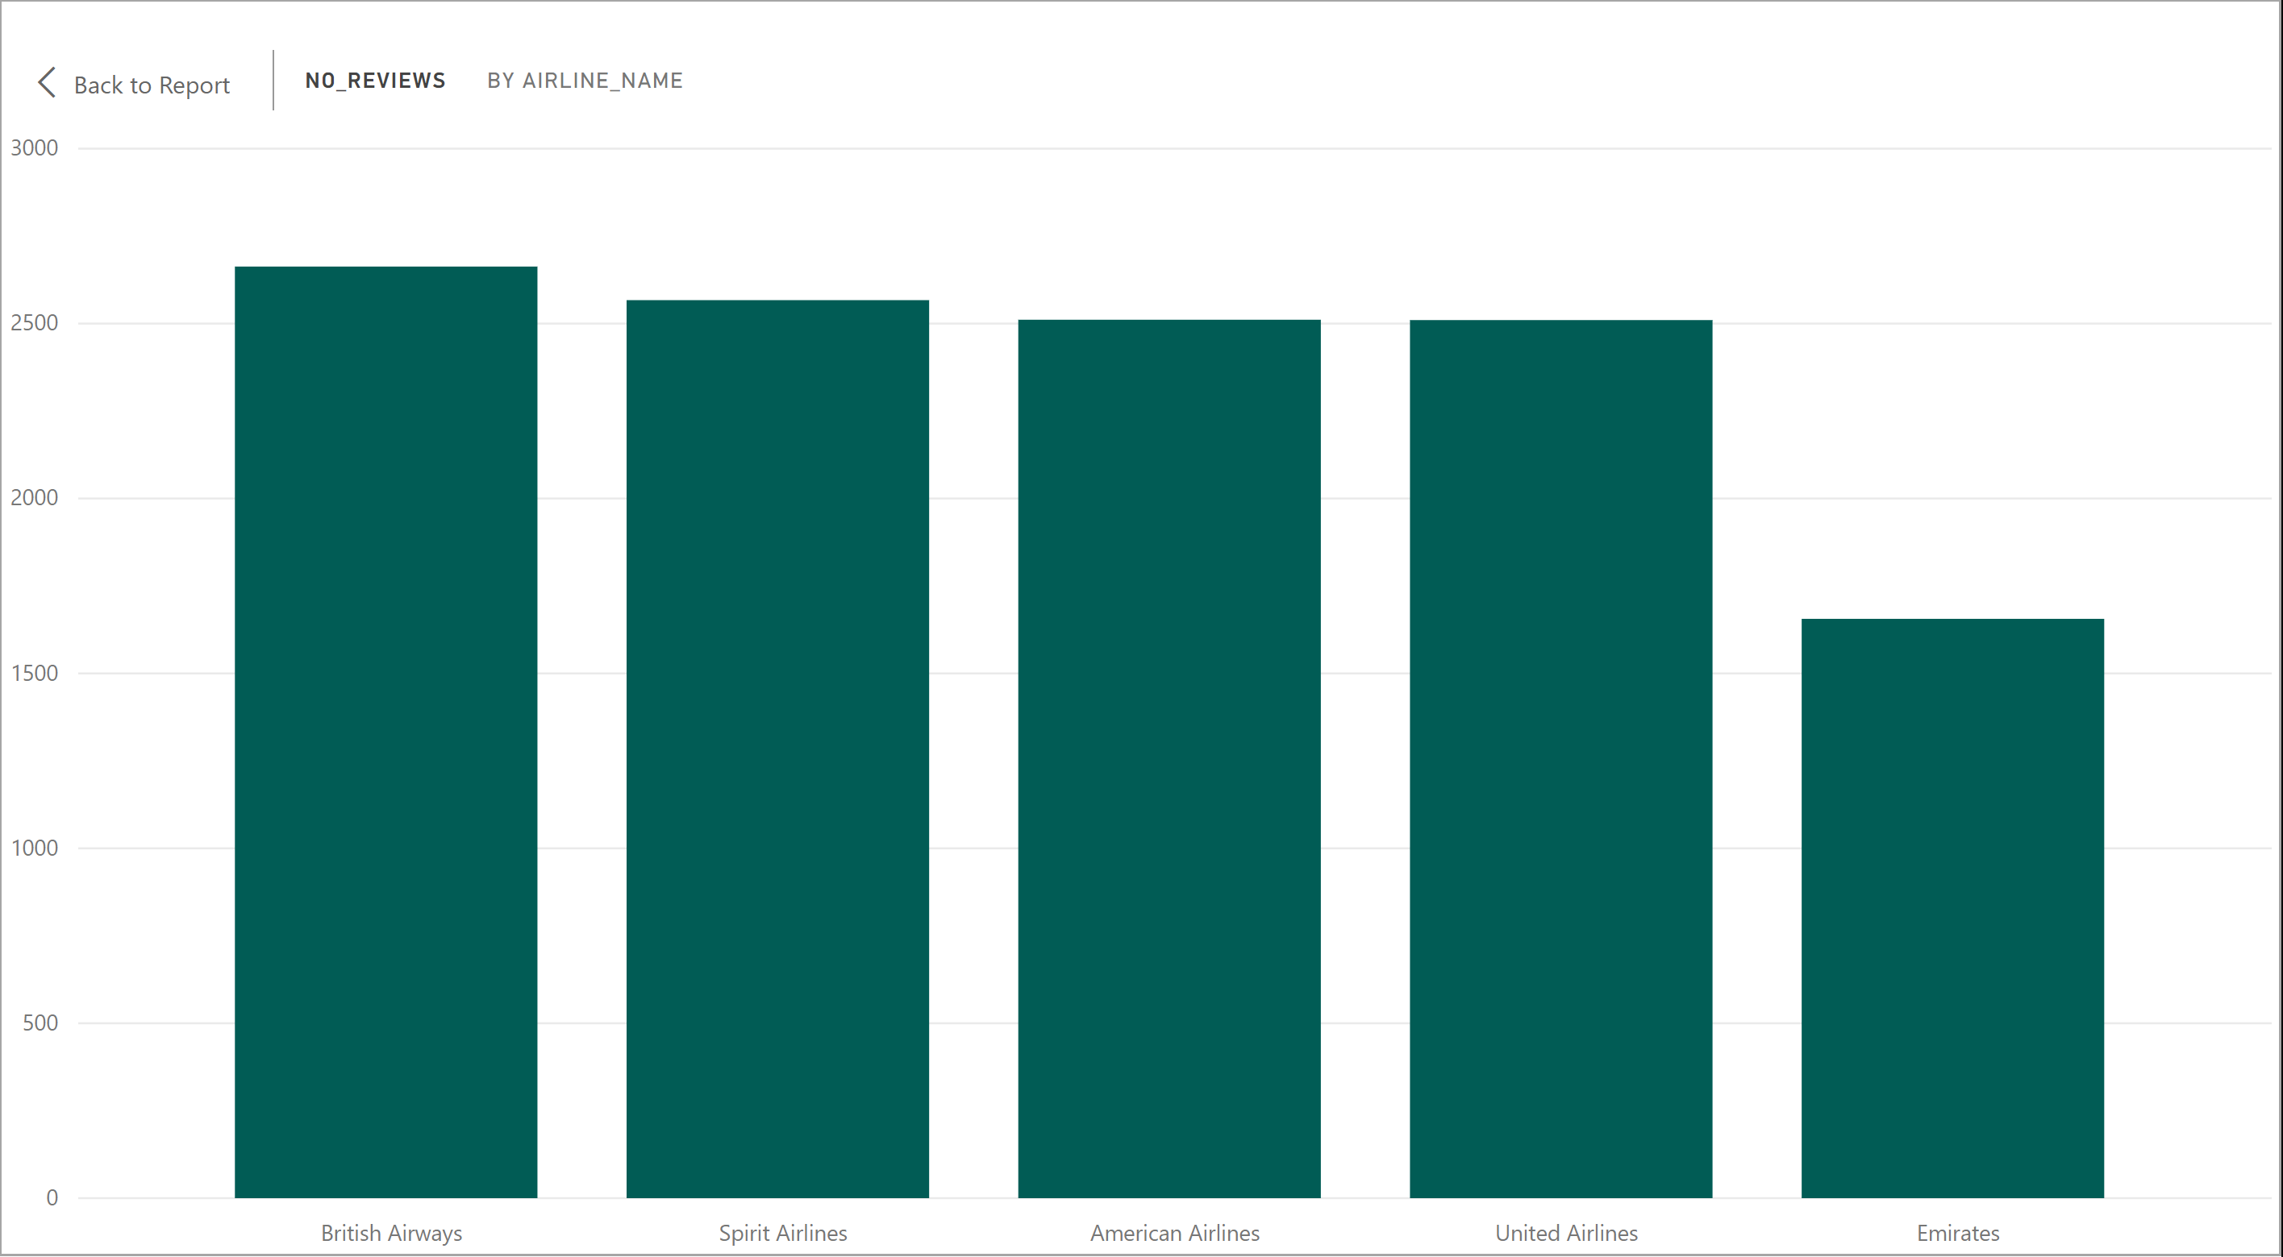
Total Number of Reviews

Slide 12
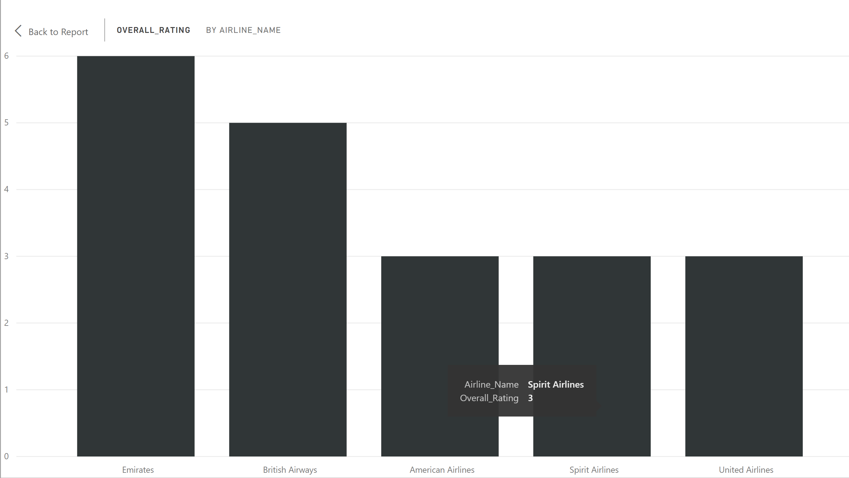
Overall Rating

Slide 13
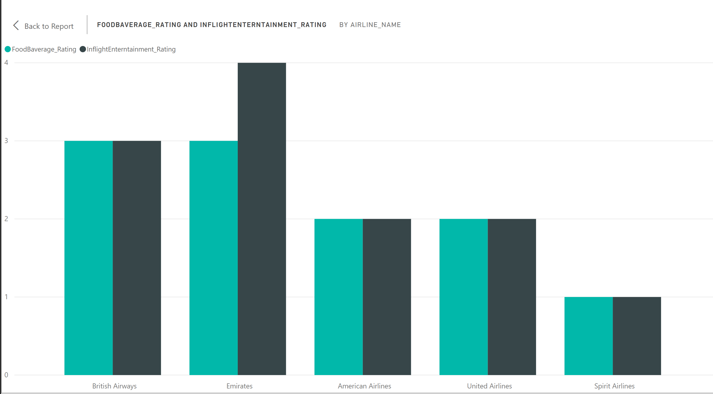
Food, Beverage and Inflight Rating

Slide 14
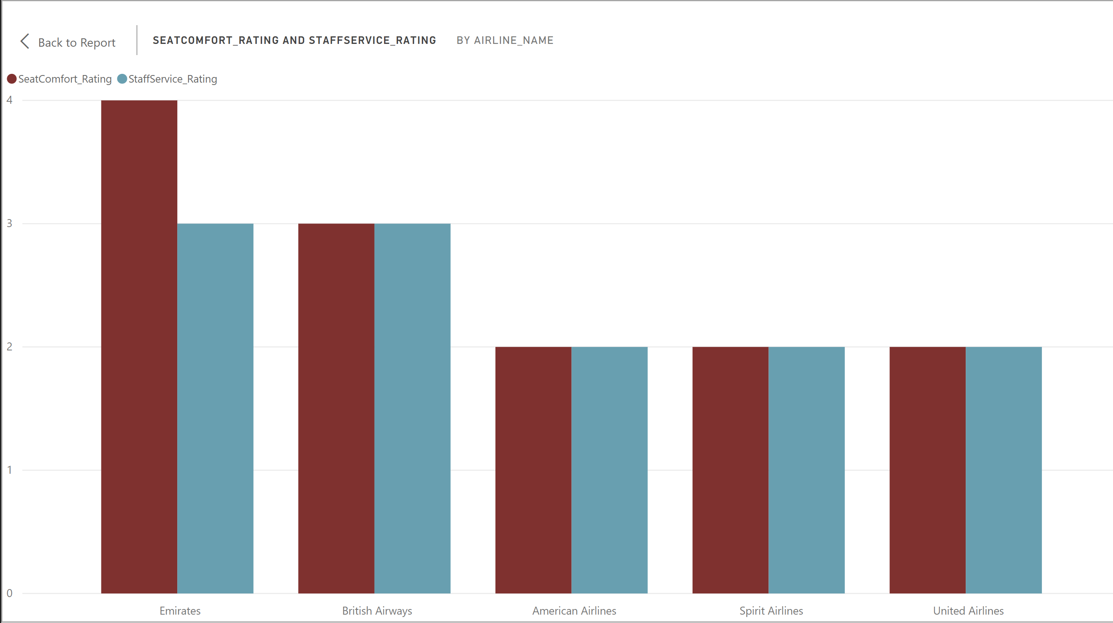
Staff Service and Seat Comfort Rating

Slide 15
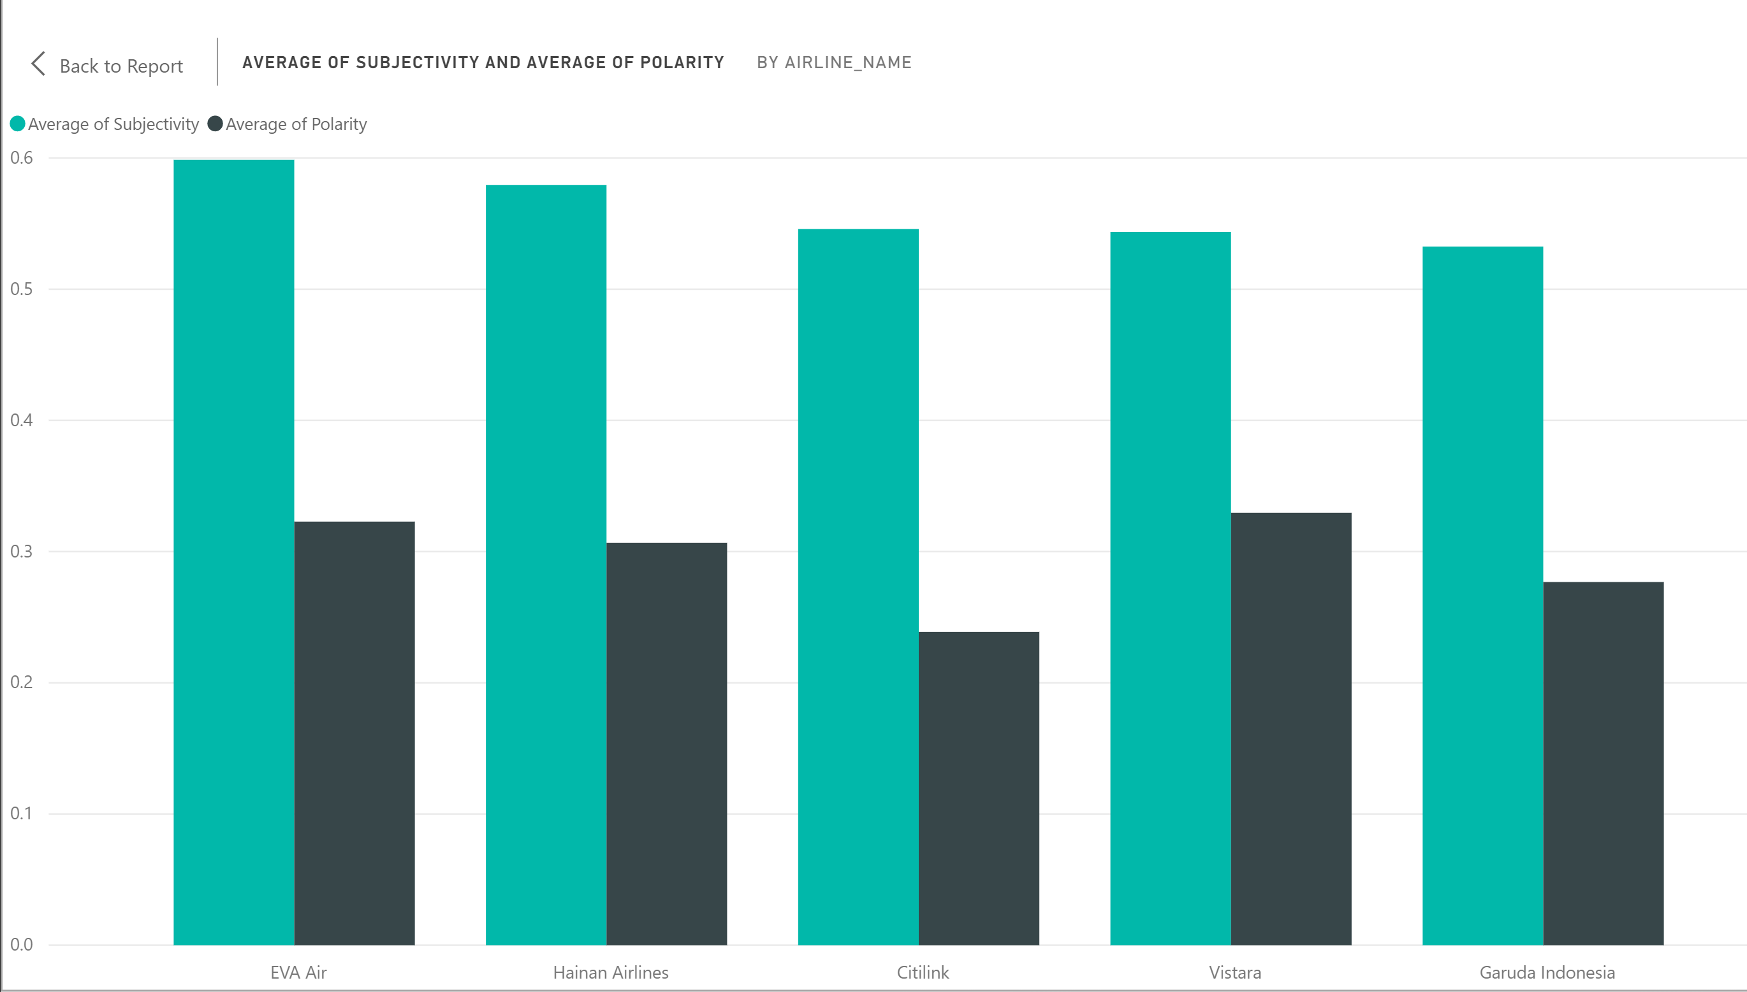
Average of polarity and Subjectivity

Slide 16
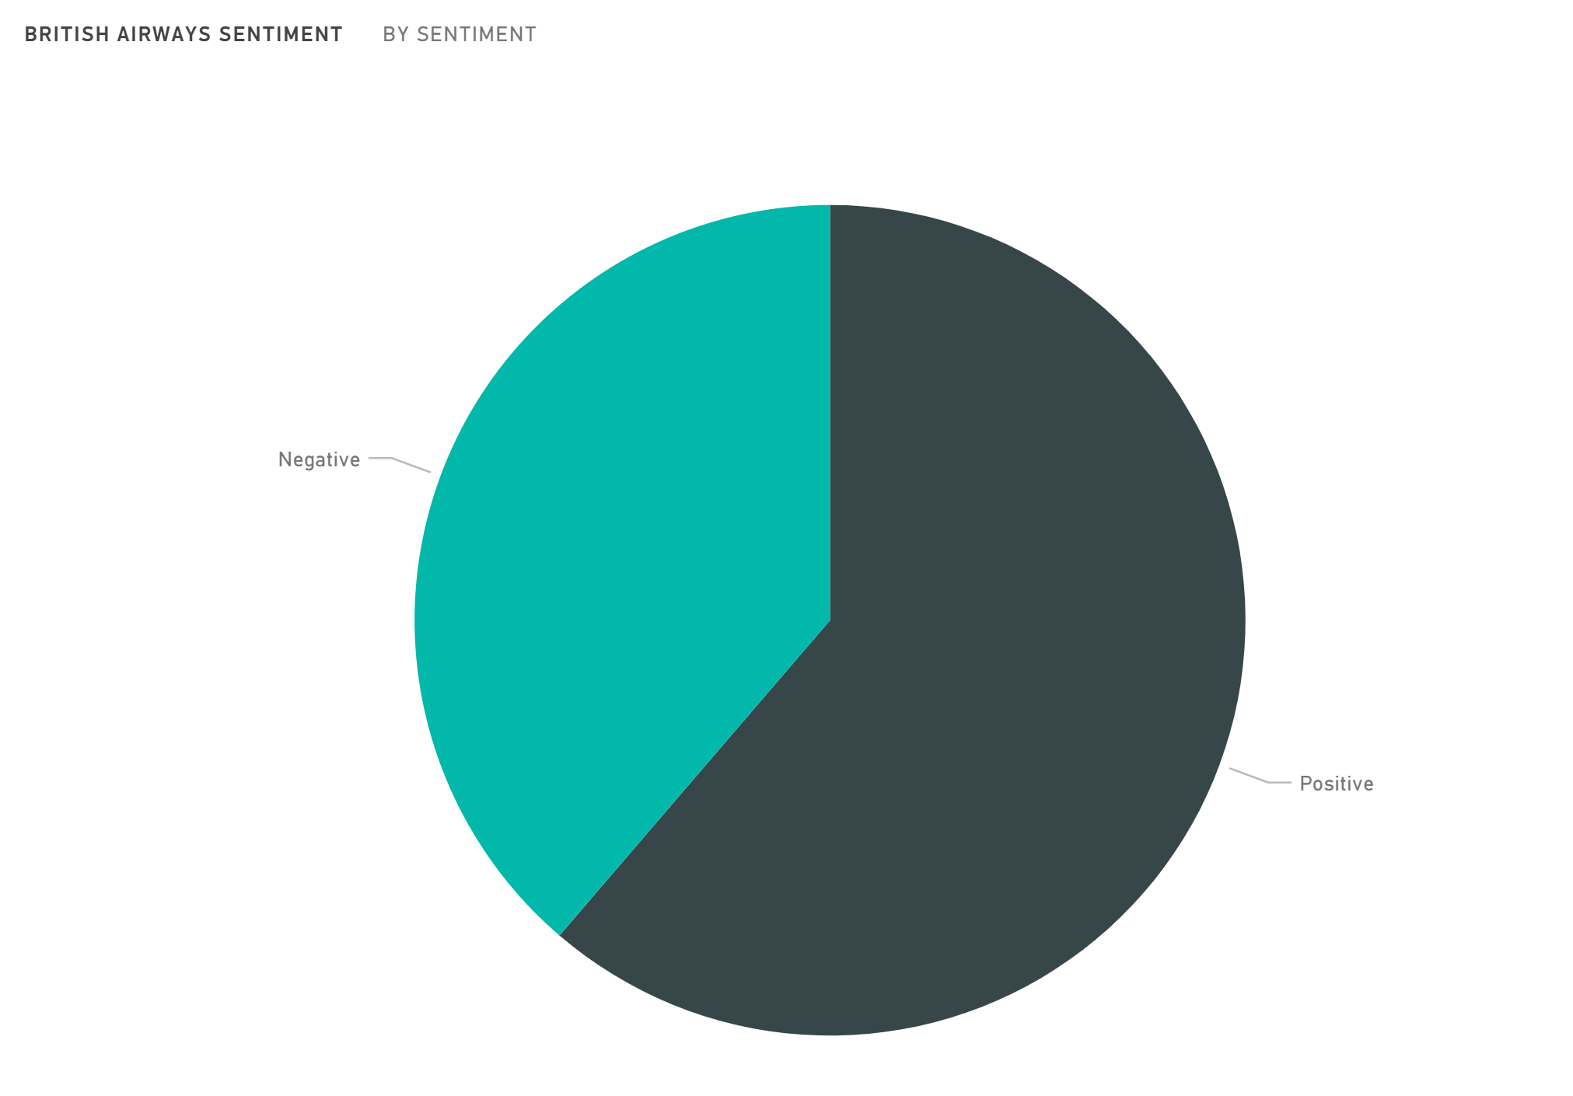
British Airways Sentiment

Slide 17
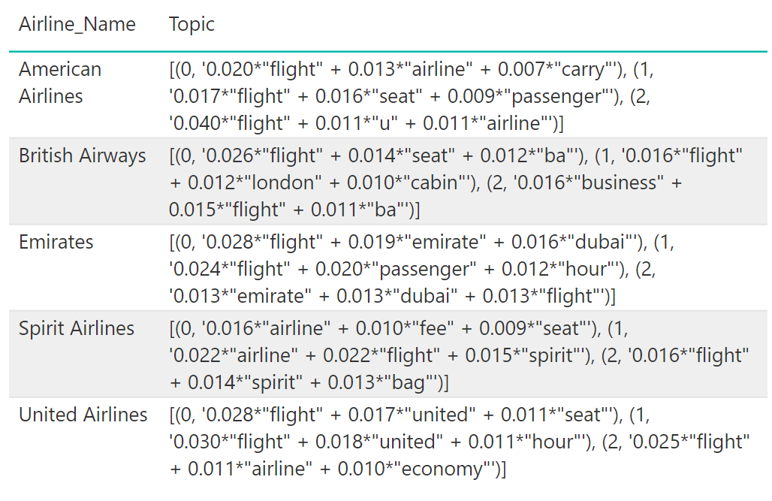
Topic Modeling

Slide 18
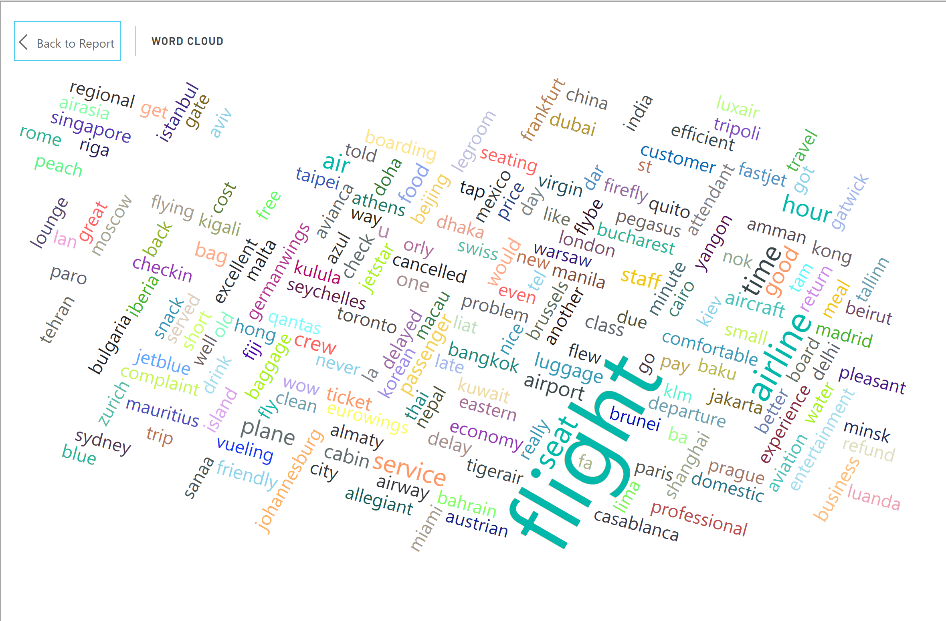
Word Cloud

Slide 19
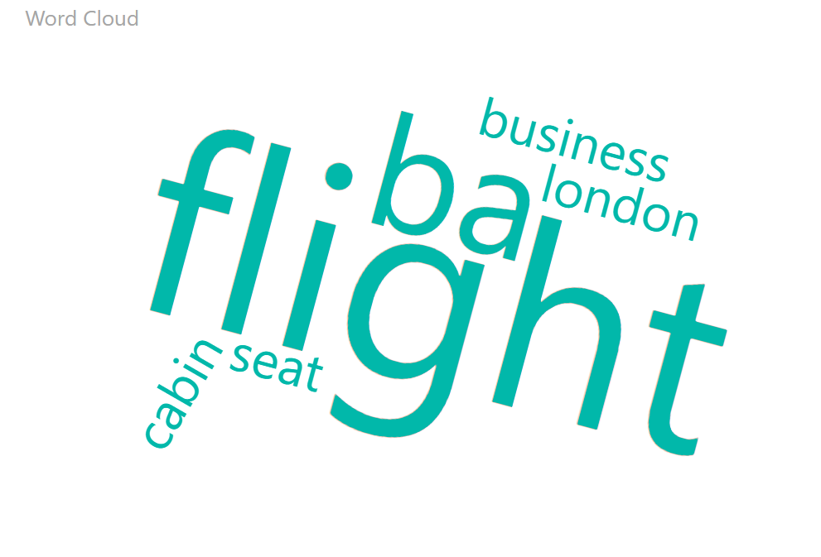
Word Cloud for British Airlines

Slide 20


